Slide 1
Tracking and Enhancing Your Research Impact
Sheila Craft-Morgan, JD, MLS
Research Impact Librarian and Assistant Professor
University Libraries

Slide 2

Agenda
What is research impact?
Three steps to track and enhance your research impact
https://go.osu.edu/research_impact

Slide 3
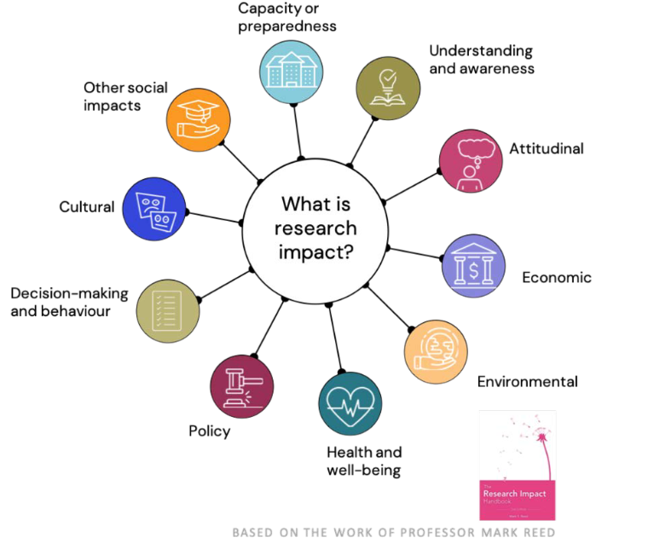
Definitions
Research Impact – how one’s research/scholarship influences others, the field and the discipline
Broader impacts – the potential to benefit society and contribute to the achievement of specific, desired societal outcomes. (NSF)
English APT documents – “quality and impact, as measured by peer reviews, the prestige of its venues, the receipt of awards, evidence of citations, and other measures of quality appropriate to the candidate’s specialty”

Slide 4
Strategies to Track and Enhance Research Impact
Manage Your Author Identity
Make Your Scholarly Work Discoverable
Gather Data
Traditional Metrics
Alternative Metrics
Tell Your Story
Collaborations, peer review, etc.
Promote Your Work
Describe the Impact of Your Scholarship
Preparation

Slide 5

Manage Your Author Identity
Register for an ORCID iD

Slide 6

What is ORCID?
Open Researcher and Contributor ID
  ORICID id – free, unique persistent identifier
  ORCID record – name variations, employment affiliation, works, funding, peer review activity, etc.
  Works categories are inclusive for a variety types of scholarship including books, book chapters, journal publications, reviews, conference papers, lectures, etc.

Slide 7
Benefits of Using ORCID
Link to databases (Scopus, MLA International Bibliography, Web of Science, etc.) to import information about publications and other works into ORCID record
Use ORCID in submission systems for funding, publishing and research reporting to reduce repetitive data entry
Register for an ORCID iD at https://orcid.org/register
Connect your ORCID iD to Ohio State at https://my.osu.edu

Slide 8



Manage Your Author Identity Continued
Register for an ORCID iD
Claim your Scopus, Web of Science, and Google Scholar Profiles
Link Scopus ID and Web of Science Researcher ID to ORCID

Slide 9

Make Your Scholarly Work Discoverable
Take advantage of OSU Libraries Open Access Initiatives

Slide 10
Open Access Publisher Agreements
Ohio State University Libraries has agreements with publishers that cover Open Access fees (APCs) at no cost to Ohio State corresponding authors for eligible articles and journals
Cambridge University Press
De Gruyter
Taylor & Francis
Wiley Hybrid
https://library.osu.edu/transforming-publishing
TransformPublishing@osu.edu

Slide 11
Open Access Monograph Initiative
University Libraries will provide a publishing grant of up to $10,000 to a university press to support the publication of an Open Access, digital monograph of about 90,000 words.
Three-year initiative
Ohio State faculty members can apply for Open Access subvention funds upon acceptance of their peer-reviewed manuscript by a university press.
https://library.osu.edu/transforming-publishing/open-monograph-initiative
TransformPublishing@osu.edu

Slide 12


Make Your Scholarly Work Discoverable Continued.
Take advantage of OSU Libraries Open Access Initiatives
Deposit preprints, postprints, datasets, slides, presentations, posters, etc. to open repositories
Use appropriate keywords to help your target audience find your work

Slide 13
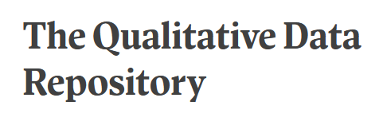
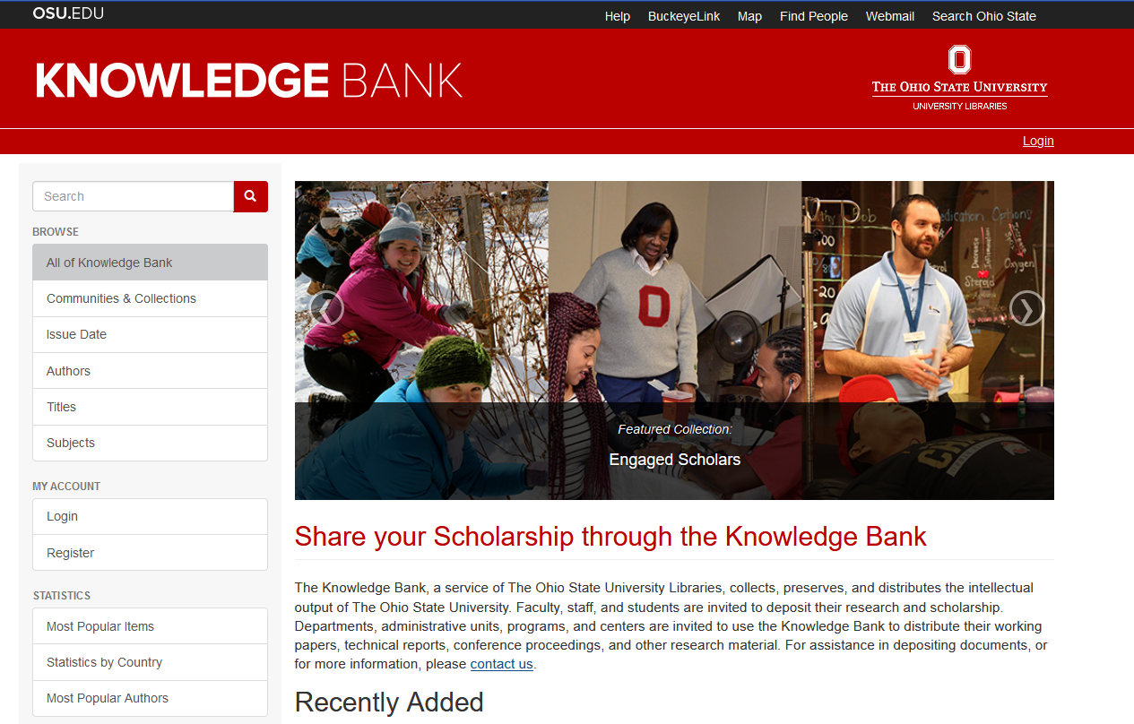
Make Your Scholarly Work Discoverable

Slide 14



Promote Your Scholarly Work
List your ORCID iD on your website, your email, and social media
Use social media (blogs, Twitter, LinkedIn, etc.) and networking sites as appropriate
Share plain language summaries of your scholarship

Slide 15
Use Scholarly Research Metrics Responsibly
Scholarly Research Metrics are merely indicators of the “quality” of scholarly research
Metrics are subject to biases in the publishing cycle (bias in peer review, publication bias, citational bias, Matthew effect, etc.) and in the bibliometric databases that provide these metrics
For more information: Metric Tide, and Harnessing the Metric Tide Revisited, Leiden Manifesto, and San Francisco Declaration on Research Assessment

Slide 16

Track Your Scholarly Research Metrics
Track Traditional Metrics

Slide 17
Traditional Metrics - Books and Book Chapters
Some books and book chapters are available in Web of Science, Scopus, and Google Scholar
Holdings in WorldCat
Reviews
Citations

Slide 18
Traditional Metrics – Journal Articles
Journal-level Metrics
Article-level Metrics
Author-level Metrics
Impact Factor/CiteScore
Scopus
Web of Science
Times cited
Scopus
Google Scholar
Web of Science
h-index
Scopus
Google Scholar
Web of Science

Slide 19
Traditional Metrics – Journal Articles part 2
Impact Factor is only from Web of Science (Journal Citation Reports)
but
Scopus has a similar measure for journals (CiteScore)

Slide 20
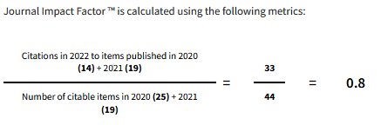
Traditional Metrics – Journal Articles part 3
Journal Impact Factor = the number of citations to items with a publication date from the prior two years divided by the number of citable items this journal published in the prior two years

Slide 21
Traditional Metrics – Journal Articles part 4
The 2023 release of Journal Citation Reports included a Journal Impact Factor (JIF) for all Web of Science Core Collection journals including journals in the Arts and Humanities Citation Index (AHCI) and the Emerging Sources Citation Index (ESCI).

Slide 22
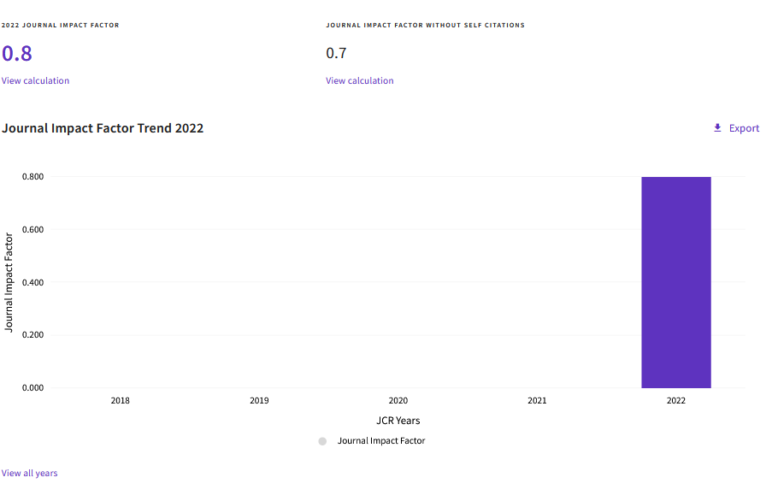
College English Graph
College English

Slide 23
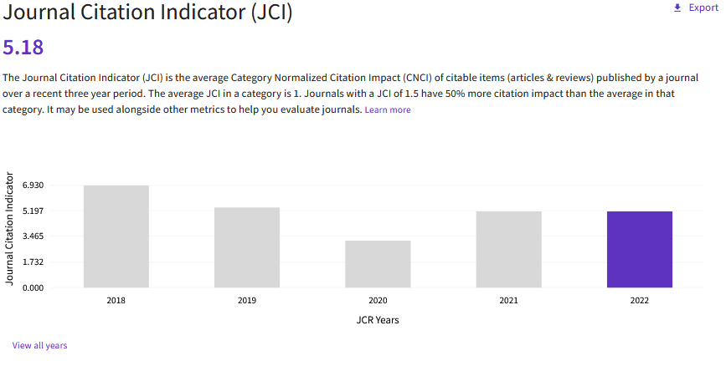
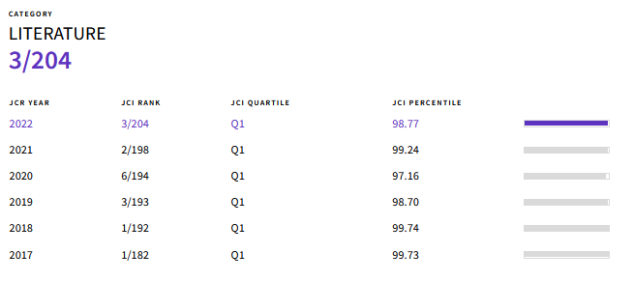
College English Journal Citation Indicator Graph
College English

Slide 24
Traditional Metrics – Journal Articles part 5
CiteScore = the number of citations to documents (articles, reviews, conference papers, book chapters, and data papers) by a journal over four years, divided by the number of the same document types indexed in Scopus and published in those same four years.

Slide 25
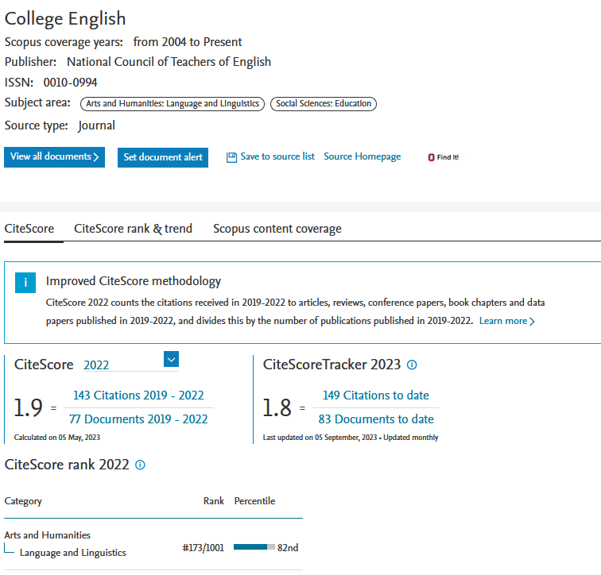
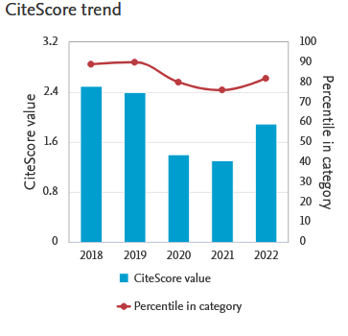
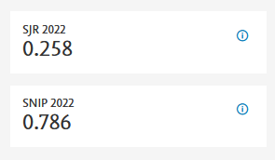
College English Score Trends

Slide 26
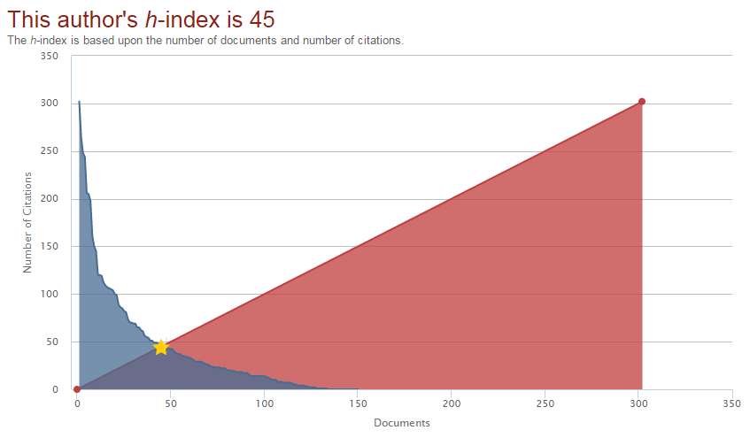
Traditional Metrics – Author Metrics
h-index = the number of articles (h) of an author that have received at least (h) citations over time.

Slide 27
Traditional Metrics - Other
Journal Acceptance rates
  Journal website
  Cabells Journalytics
Subscriptions and Circulation
Audience size – webinars, lectures and readings

Slide 28

Track Your Scholarly Metrics
Track Traditional Metrics
Gather Alternative Metrics

Slide 29
Gather Alternative Metrics
Usage
Clicks/Views
Downloads
Captures
Bookmarks
Favorites
Forks
Likes/Mentions
Blogs Posts
Comments
Social Media

Slide 30
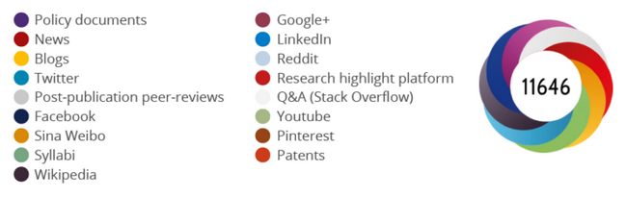
Gather Alternative Metrics part 2
The Altmetrics Attention Score is a weighted count of all of the attention a research output has received.
Available using the Altmetric Bookmarklet
https://www.altmetric.com/solutions/free-tools/bookmarklet/

Slide 31
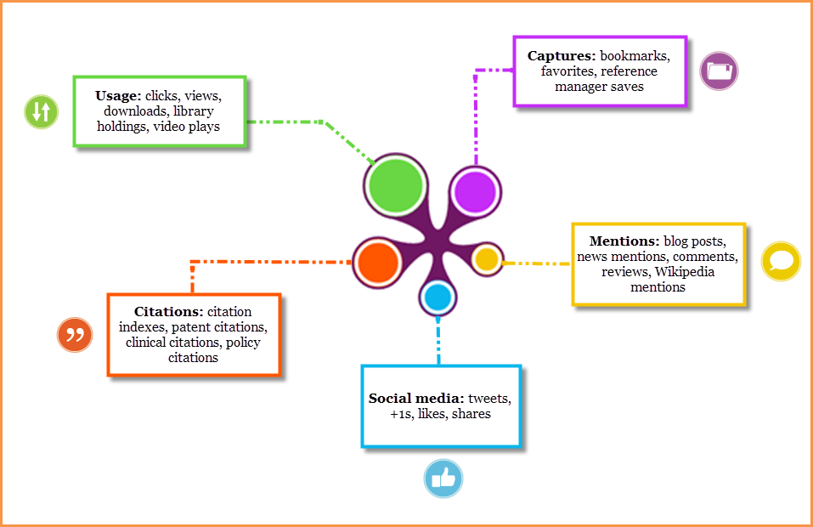
Gather Alternative Metrics part 3
PlumX Metrics provides comparable data that show how people interact with individual pieces of research output.
Available in Scopus

Slide 32
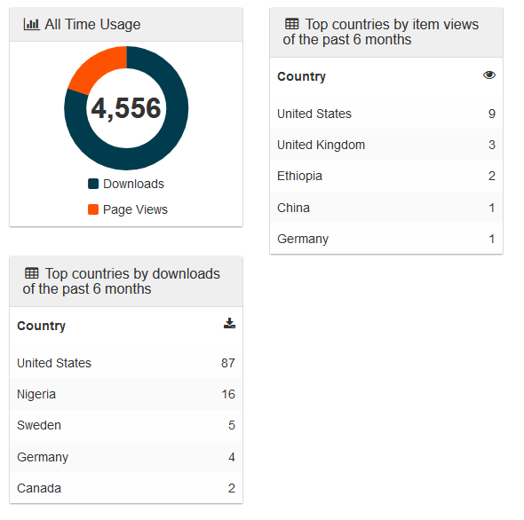
Gather Alternative Metrics part 4
Views and downloads may be available in open repositories
Metrics may also be available on journal websites
Langley, April. The Black aesthetic unbound: theorizing the dilemma of eighteenth-century African American literature. (Ohio State University Press), 2007,
http://hdl.handle.net/1811/30105

Slide 33
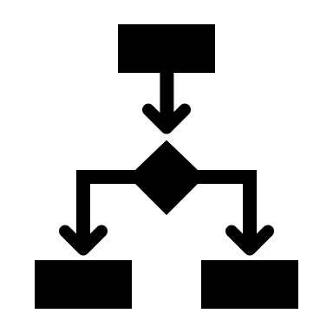
Track Your Scholarly Metrics Continued
Track Traditional Metrics
Gather Alternative Metrics
Track and describe your collaborations and references in syllabi

Slide 34
Tell Your Story
Develop a summary that describes your work and its impact that can be tailored to different audiences
Use metrics and other indicators to describe the way that your work has influenced your field and the world
Think about broader impacts

Slide 35

Broader Impacts
Research Output
Advancement of Knowledge
Legislation and Policy
Economic Benefit
Community Benefit
https://becker.wustl.edu/impact-assessment/

Slide 36
Questions?
https://go.osu.edu/research_impact
Sheila Craft-Morgan, JD, MLS
Research Impact Librarian and Assistant Professor
craft-morgan.1@osu.edu

